Slide 1
MCU
Interrupts and PWM

Slide 2
Interrupts
Hackerboard / ESP32

Slide 3
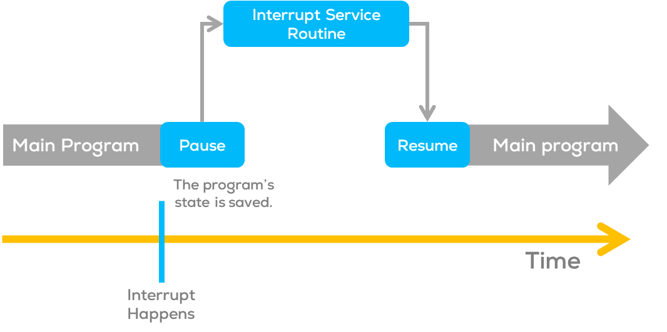
Interrupts
  Interrupts
  Interrupts are signals that temporarily pause the main program to handle specific events.
  Such signals can come from external hardware or internal processes to the MCU.
  These signals are typically called triggers.
  Interrupts allow the microcontroller to respond immediately when an event occurs.

Slide 4
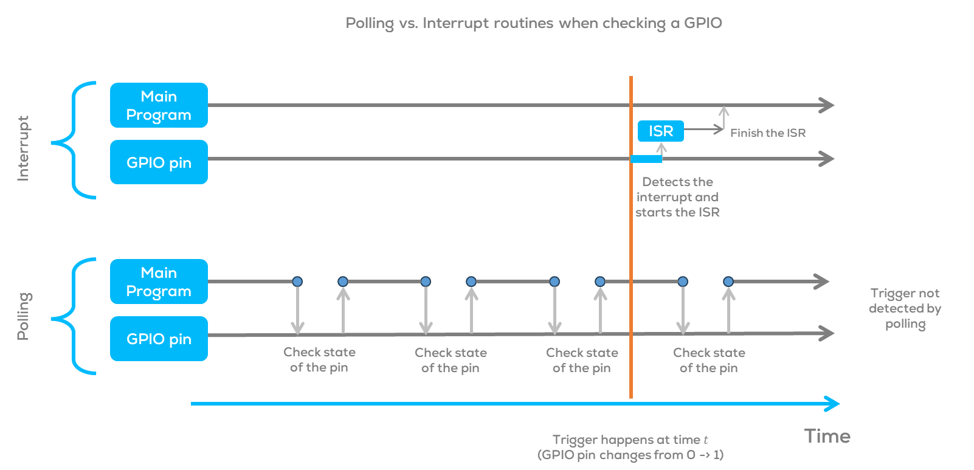
Interrupts
Advantages of Interrupts
  Multitasking capability: Handle multiple tasks simultaneously.
  Faster response time: Immediate action upon event detection.
  Lower power consumption: The microcontroller can sleep between interrupts.
  Precise timing: Ideal for time-critical tasks.
  Simplified code: No need for constant event checking.
  Compared with polling, where the user must continuously monitor the state of a variable or pin, interrupts respond to an event upon detection of the trigger signal.
Uses
Interrupts are useful when solving timing problems.
Some application examples may include reading a rotary encoder or monitoring user input (button, etc.).

Slide 5
Interrupts
Types of interrupts
External Interrupts
  Triggered by external events, falling or rising edges; such as button presses or changes in sensor signals.
  Ideal for real-time event-driven applications such as button presses, sensor readings, and rotary encoders.
Timer Interrupts
  Generated by internal timers at specific intervals.
  Useful for precise timing, generating PWM signals, real-time clock, controlling stepper motors, and time-dependent tasks.
Pin Change Interrupts
  Triggered when the logic level changes on certain pins.
  Suitable for scenarios with multiple pins changing simultaneously, like keypad inputs.
Special Interrupts
  Reset and watchdog timer interrupts.
  Essential for system recovery and managing system stability.

Slide 6
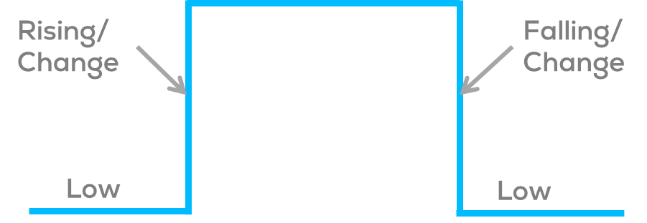
Interrupts
Interrupt Modes (Arduino and ESP32)
LOW to trigger the interrupt whenever the pin is low,
CHANGE to trigger the interrupt whenever the pin changes value
RISING to trigger when the pin goes from low to high,
FALLING for when the pin goes from high to low

Slide 7
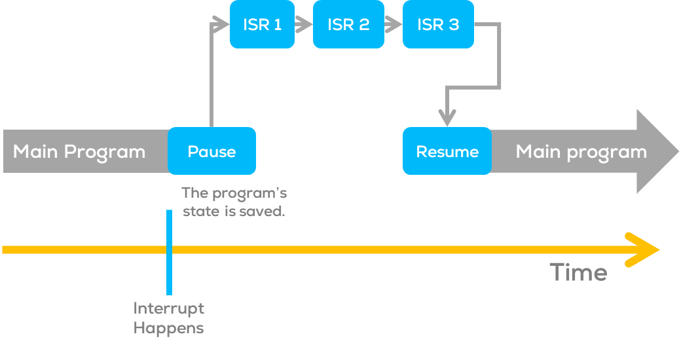
Interrupts
ISR (Interrupt Service Routines)
  Special functions that handle interrupts, allowing the microcontroller to respond immediately to events.
  ISR cannot have any parameters and shouldn’t return anything.
When an interrupt occurs, the microcontroller pauses the main program and jumps to the corresponding ISR.
ISR executes, performs the necessary actions, and then returns to the main loop.
Warning:
  In Arduino, the functions millis(), delay() and micros() rely on interrupts to count, so they will never increment inside an ISR.
  When multiple ISRs are used, only one can run at a time. After the current one finishes, the rest of the interrupts will be executed in an order that depends on their priority. More information about priority can be found here.

Slide 8
Interrupts
Flags
  Interrupts use flags for different purposes; in Arduino and ESP the most common flags used are
    interrupts(): Re-enables interrupts (after they’ve been disabled.
      Interrupts allow specific tasks to happen in the background and are enabled by default.
    nointerrupts(): Disables interrupts (you can re-enable them with interrupts()).
      Some functions will not work while interrupts are disabled, and incoming communication may be ignored.
      Interrupts can slightly disrupt the timing of code, however, and may be disabled for particularly critical code sections.
Variables
Typically, global variables are used to pass data between an ISR and the main program.
The variables used in an ISR must be declared as volatile.
  Declaring variables as volatile, tells the compiler that such variables might change at any time, and thus the compiler must reload the variable whenever you reference it, instead of copying the value.
    volatile int var;
    volatile boolean flag;

Slide 9
ESP32 Interrupts
Configuring & Handling ESP32 GPIO Interrupts In Arduino IDE
The following procedure mustpin-by-pined to configure Interrupts on the ESP32.
Attach Intterupt to a pin
  attachInterrupt() set an interrupt on a pin.
  GPIOPin –GPIO pin for the external interrupt.
  ISR – is the name of the Interrupt service routine (callback function) it can be any name as long as the function is called the same.
  Mode – defines interrupt mode: LOW,CHANGE, RISING,FALLING.
Set up an ISR (Interrupt service routine)
  Change the “ISR” to another name as long as it’s the same as when declared on “attachInterrupt()” function.
  An ISR cannot have any parameters, and they should not return anything.
  ISRs should be as short and fast as possible as they block normal program execution.
  They should have the IRAM_ATTR attribute, according to the ESP32 documentation.
void IRAM_ATTR ISR() {
Statements;
}
attachInterrupt(GPIOPin, ISR, Mode);

Slide 10
Activity 1
Interrupts

Slide 11
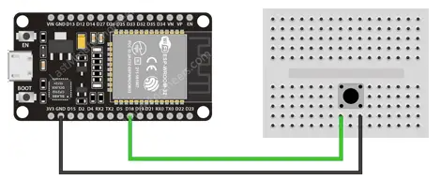
Interrupts: Example
struct Button {
const uint8_t PIN;
uint32_t numberKeyPresses;
bool pressed;
};
Button button1 = {18, 0, false};
void IRAM_ATTR isr() {
button1.numberKeyPresses++;
button1.pressed = true;
}
void setup() {
Serial.begin(115200);
pinMode(button1.PIN, INPUT_PULLUP);
attachInterrupt(button1.PIN, isr, FALLING);
}
void loop() {
if (button1.pressed) {
Serial.printf("Button has been pressed %u times\n", button1.numberKeyPresses);
button1.pressed = false;
}
}
  This example expects an external interrupt given by a switch connected to GPIO 18 of the ESP32.
  Normally, you should use digitalPinToInterrupt(pin), rather than place an interrupt number directly into your sketch.

Slide 12
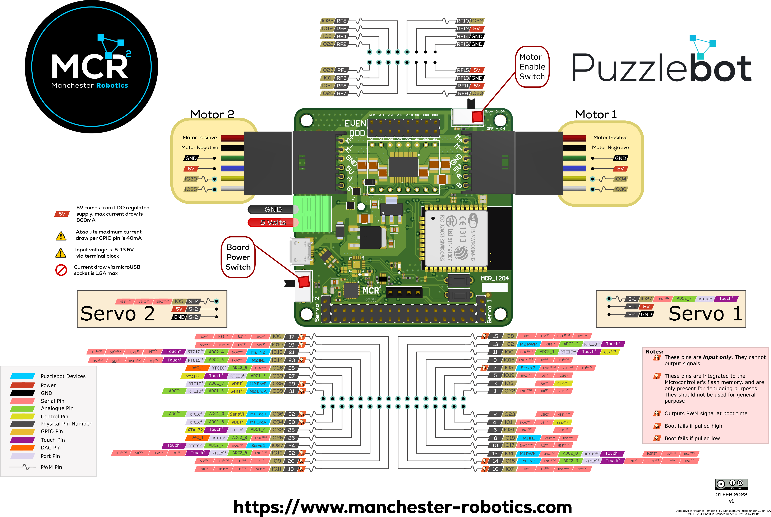
Hackerboard Pinout

Slide 13
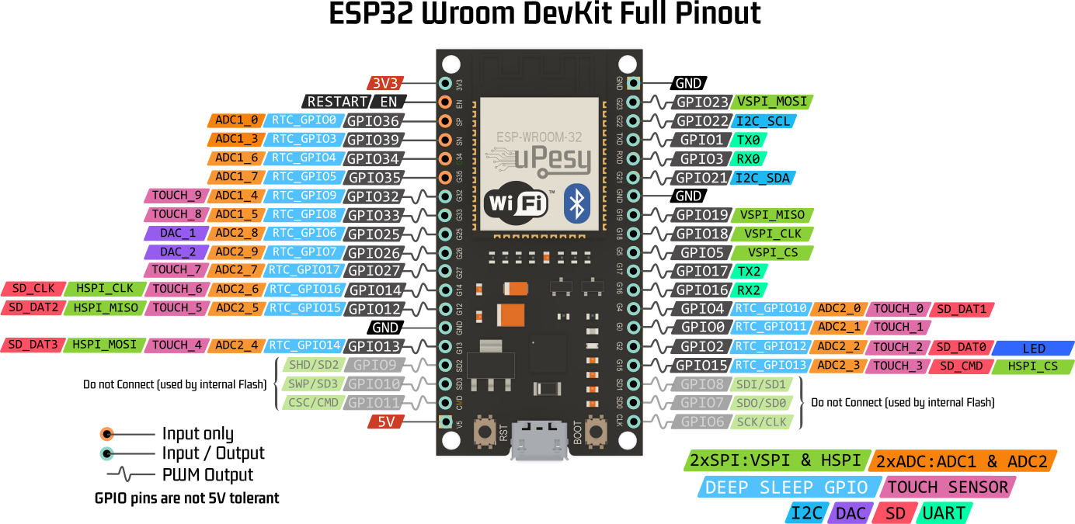
ESP32 Pinout

Slide 14

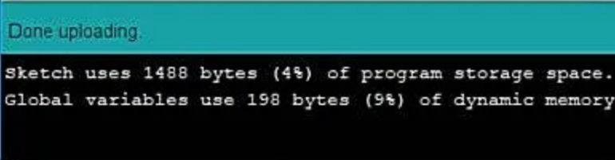
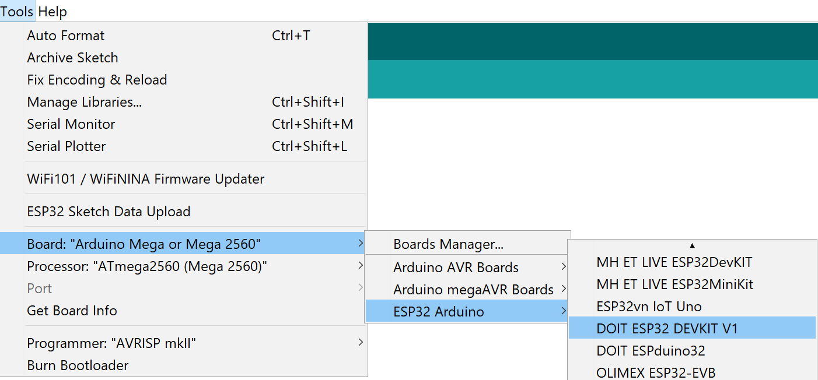
Activity
Uploading (Arduino IDE)
Connect the Hackerboard or the ESP32 board
Select the port to be used Tools>Port
Select the board to be used Tools -> ESP32 Arduino > DOIT ESP32 DEVKIT V1 (for Hackerboard is the same)
Upload the code using the arrow on the top left corner of the IDE.
The following message should be displayed:
Open the terminal

Slide 15
PWM Signals
Hackerboard/ESP32

Slide 16
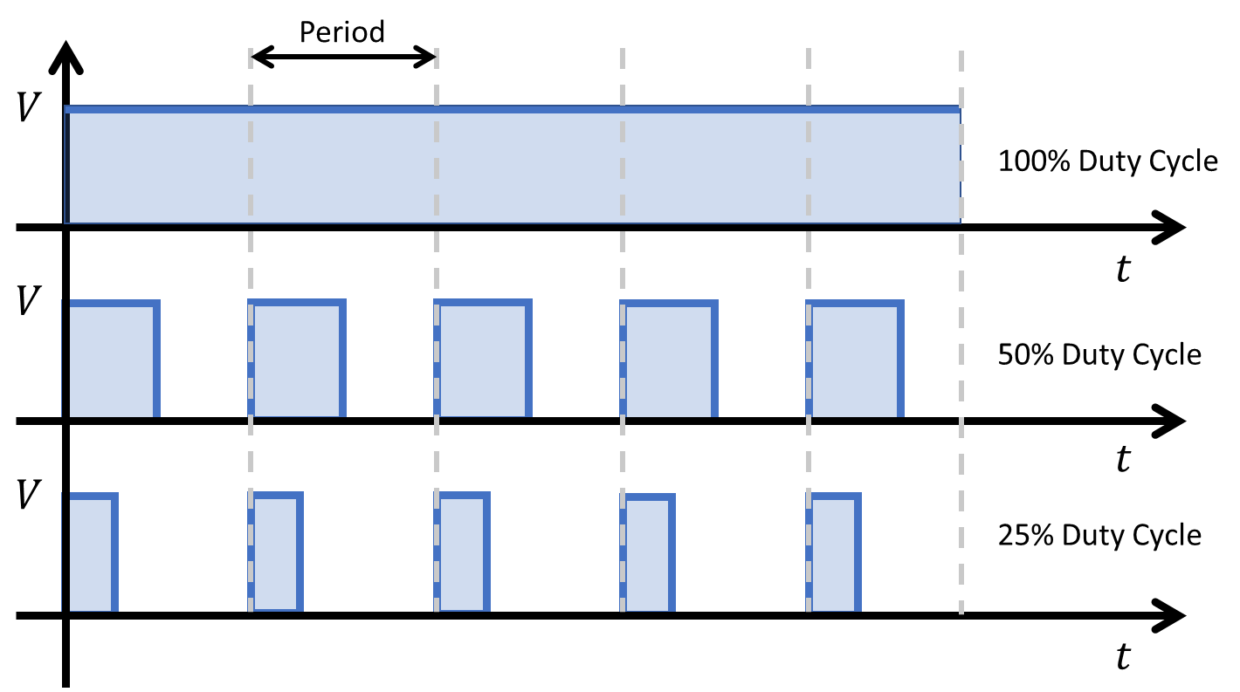
PWM
What is PWM?
PWM stands for Pulse Width Modulation.
It's a technique used in electronics to control the average voltage or current delivered to a device by rapidly switching between full power and no power (On/Off) over a fixed period of time.
This creates an average voltage or current somewhere in between, effectively controlling the output (power delivered to the system).
The duration of "on time" is called the pulse width.
To get varying analog voltage values, the pulse width can be changed “modulated”.

Slide 17
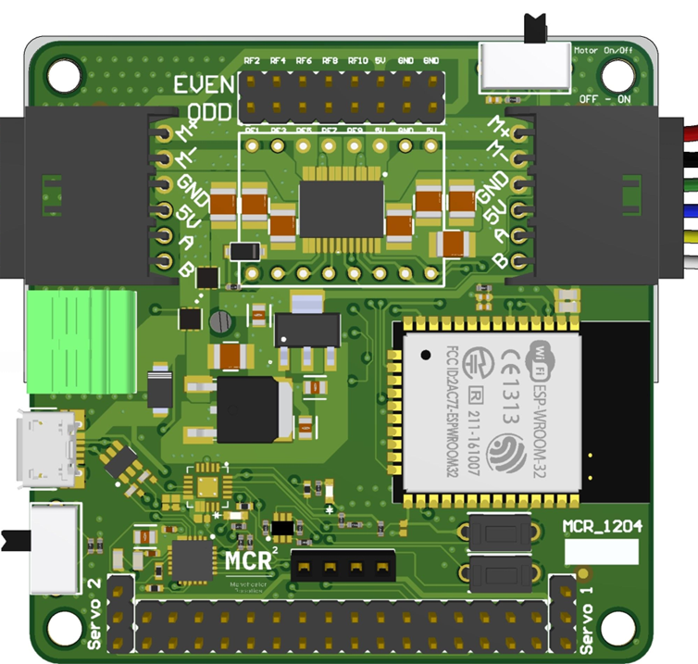
PWM
Why Use PWM on ESP32?
PWM is commonly used to control things like motor speed, LED brightness, and even audio signals.
It's an efficient way to simulate varying levels of output using digital control, like from a microcontroller such as the ESP32.
The ESP32 has a dedicated LEDC (LED Controller) peripheral for PWM.
It supports up to 16 PWM channels with configurable frequencies and resolutions.
Unlike Arduino, ESP32 allows more precise PWM control.

Slide 18
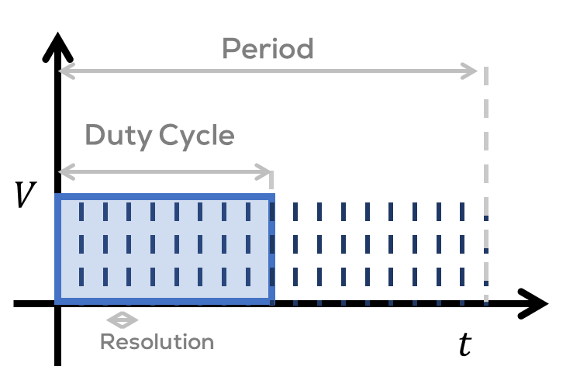
ESP32 PWM
ESP32 PWM
The ESP32 LEDC library provides hardware-accelerated PWM.
You can configure for each PWM signal:
  Frequency (Hz)
  Resolution (bits, up to 16-bit precision)
  Duty cycle (0 - max resolution value)
PWM resolution is the number of distinct levels or steps that a PWM signal can have within its duty cycle range. In other words, is the granularity with which the duty cycle can be modulated.
Each PWM signal on the ESP32 is assigned to a channel. The channel is used to configure parameters previously mentioned.
To generate a PWM signal on a specific pin, you “attach” that pin to a channel.
This tells the ESP32 to output the PWM waveform generated by the channel on the specified pin. Multiple pins can be attached to the same channel, which means they can all output the same PWM signal.

Slide 19
Activity 2
PWM

Slide 20
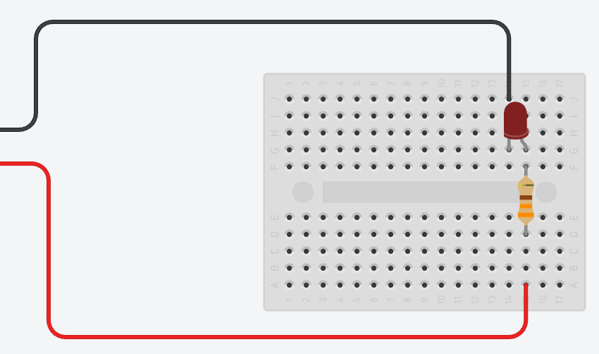
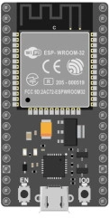
Circuit
GND
PIN 22

Slide 21
ESP32 PWM
const int PWM_CHANNEL = 0; // ESP32 has 16 channels which can generate 16 independent waveforms
const int PWM_FREQ = 500; // Recall that Arduino Uno is ~490 Hz. Official ESP32 example uses 5,000Hz
const int PWM_RESOLUTION = 8; // We'll use same resolution as Uno (8 bits, 0-255) but ESP32 can go up to 16 bits
// The max duty cycle value based on PWM resolution (will be 255 if resolution is 8 bits)
const int MAX_DUTY_CYCLE = (int)(pow(2, PWM_RESOLUTION) - 1);
const int LED_OUTPUT_PIN = 22;
const int DELAY_MS = 4; // delay between fade increments
void setup() {
// Sets up a channel (0-15), a PWM duty cycle frequency, and a PWM resolution (1 - 16 bits)
// ledcSetup(uint8_t channel, double freq, uint8_t resolution_bits);
ledcSetup(PWM_CHANNEL, PWM_FREQ, PWM_RESOLUTION);
// ledcAttachPin(uint8_t pin, uint8_t channel);
ledcAttachPin(LED_OUTPUT_PIN, PWM_CHANNEL);
}
void loop() {
// fade up PWM on given channel
for(int dutyCycle = 0; dutyCycle <= MAX_DUTY_CYCLE; dutyCycle++){
ledcWrite(PWM_CHANNEL, dutyCycle);
delay(DELAY_MS);
}
// fade down PWM on given channel
for(int dutyCycle = MAX_DUTY_CYCLE; dutyCycle >= 0; dutyCycle--){
ledcWrite(PWM_CHANNEL, dutyCycle);
delay(DELAY_MS);
}
}
Setting Up a PWM Channel
To use PWM with LEDC on ESP32, follow these steps:
  Select a channel (0 to 15)
  Set the frequency (e.g., 5000 Hz for LED dimming or motor control)
  Set the resolution (typically 8-bit, 10-bit, or 12-bit)
  Attach a GPIO pin or pins to the channel
  Write duty cycle values (0 to max resolution value)

Slide 22
Hackerboard Pinout

Slide 23
ESP32 Pinout

